Slide 16
Thank you AGAIN for attending today’s sessioN: AI, Technology and the unbalanced realm of kidnapping, ransom and Extortion PLEASE REMEMBER TO COMPLETE THE EVALUATION WITHIN THE APP. Enjoy your next session!
Notes:
Required end slide – Please edit and insert your session title name.

Slide 17
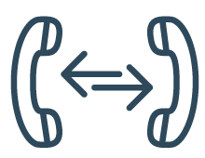
GSX ICONS

Slide 18
GSX COLOR PALETTE

